Slide 1
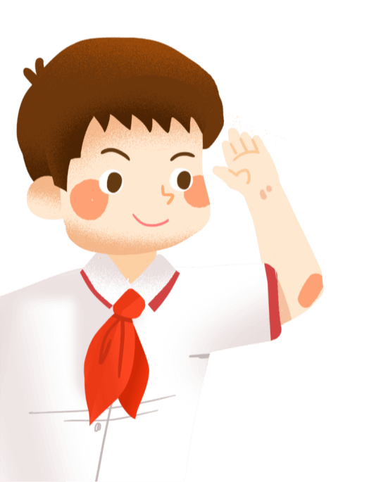
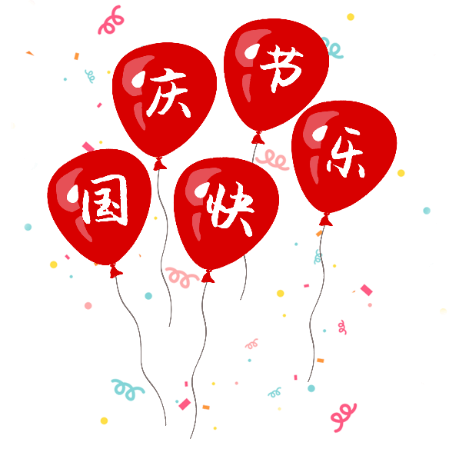
National Day English Introduction
10月1日国庆节英文介绍

Slide 2
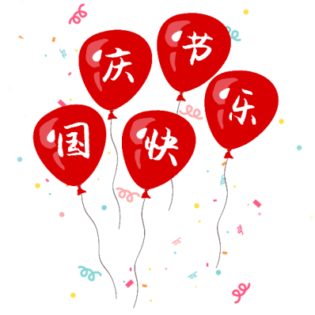
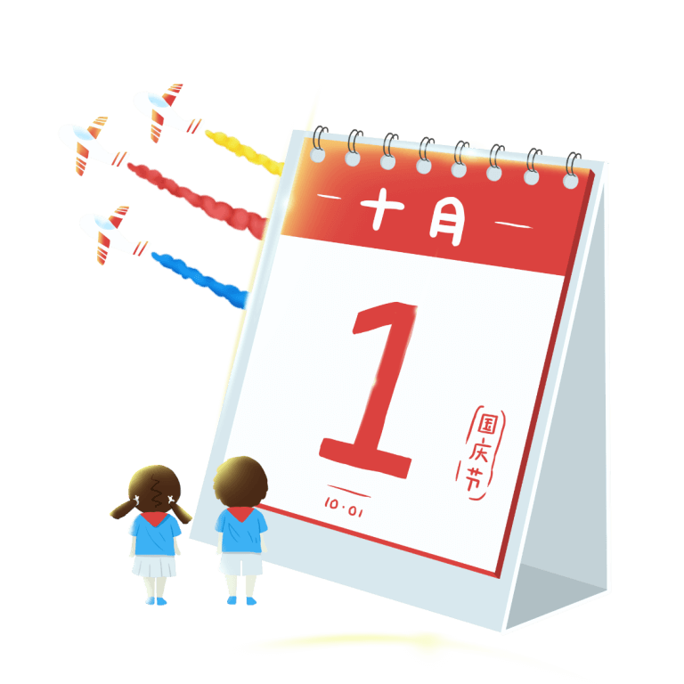
目录
起源
Origin of National Da
国庆习俗
National Day customs
其他国家国庆节
National Day of other countries
国庆节相关词句
National Day Related words and sentences
国庆节祝福语
National Day blessing

Slide 3
Origin of National Da
PART ONE

Slide 4
https://www.ypppt.com/
01
The Date 日期
In our country, especially the National Day of the Republic of China was formally ( 正式地) established on October 1st.
在我国，国庆节特指中华人民共和国正式宣告成立的10月1日。
10月1日

Slide 5
01
Origin of National Da
National Day" the term refers to the national celebration of the matter, was first seen in the Western Jin Dynasty(西晋时代). Western Jin Dynasty writer Lu in the "Five other princes (王子/诸侯/贵公子) theory" a text once the "National Day alone its benefit, the main sorrow (悲伤) harms" there cord(记载)，China's feudal(封建制度的) era (时代;年代;纪元)，the national celebration of the event, too great imperial (至高无上的) throne (王座;君主;王权)，birthday(Qing emperor's birthday is called Viva Festival万岁(表示祝愿或赞成的欢呼声) ) and so on. Thus in ancient China thee emperor (皇帝) ascended (登基) the throne (登上王座)，birthday is called the "National Day." Said today that the country was founded on the anniversary (周年纪念日) of the National Day.

Slide 6
01
国庆起源
“国庆节”这个词是指全国性的庆祝活动，最早见于西晋时期(西晋时代). 西晋作家吕中的“其他五王公”(王子/诸侯/贵公子) 《论》一文一度“国庆节独其利，主其悲”(悲伤) “伤害”在那里(记载)，中国的封建社会(封建制度的) 时代(时代;年代;纪元)，全国性的庆典活动，太盛大了(至高无上的) 王位(王座;君主;王权)，生日（清朝皇帝的生日被称为万岁节万岁(表示祝愿或赞成的欢呼声) ) 诸如此类。在古代中国，皇帝就是这样(皇帝) 上升(登基) 王位(登上王座)，生日被称为“国庆节”。今天有人说，这个国家是在这一周年纪念日建立的(周年纪念日) 国庆节。

Slide 7
01
中国国庆
October 1st 1949 is the birthday of the China. There solution announced the day of founding of the People's Republic of China will be the National Da yon first of October every year.
10月1日
1949年10月1日，是新中国的诞生日。同年，中央人民政府委员会第四次会议，通过了《关于中华人民共和国国庆日的决议》，决定每年10月1日，为中华人民共和国国庆日。

Slide 8
National Day customs
PART two

Slide 9
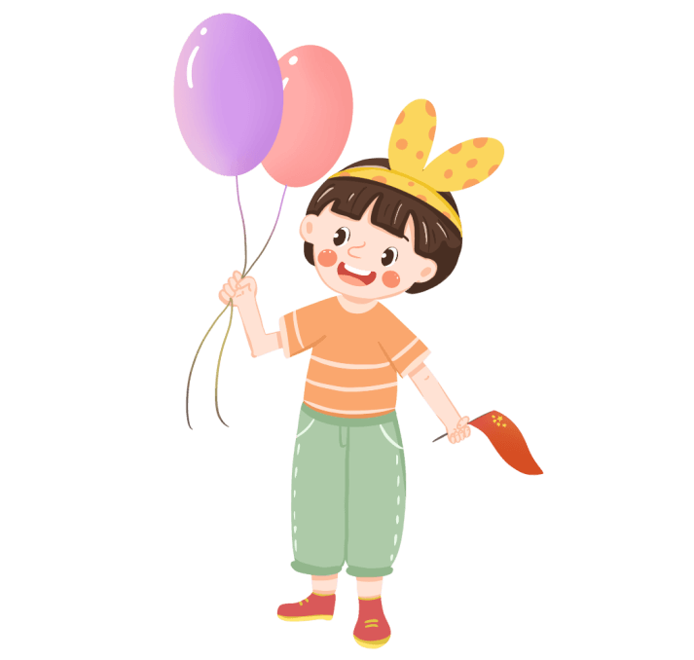
02
国庆习俗
National Day customs
Every time meets the National Day, the various countries all must hold the different form celebration. Order to celebrate the National Day, the various countries' government usually must hold a time of National Day reception, by the head of state, the head of government or foreign minister acts on behalf of to manage, the invitation is stationed at the locality the various countries' diplomatic agent and other important foreign guests participates.
每逢国庆日，各国都要举行不同形式的庆祝活动。为庆祝国庆日，备国政府要举行一次招待会，邀请各国使节和其他外宾参加。

Slide 10
02
国庆习俗
National Day customs
升国旗
Let US see the general process National Day .
让我们看看国庆节的大改流程!
NO.1 Raising of the national flag升国旗
NO.2 Militany parade 阅兵式
阅兵式

Slide 11
02
Parade阅兵
According to the decision of the CPPCC in 1949 when the People's Republic of China was founded, military parade should be listed among the key programs of the Grand Celebrations of National Day there after. A total number of 11 parades were conducted during the coming ten years since then, which however were followed by a break-up for a consecutive period of 24 years. The parade was not resumed until 1984.
1949年中国的军事阅兵被列为重点项目。不过在进行了11次之 后停滞了连续24年， 直到1984年才恢复 阅兵。
阅兵式
节日PPT模板 http://www.ypppt.com/jieri/

Slide 12
National Day of other countries
PART THREE

Slide 13
03
其他国家国庆节
National Day of other countries
America :July 4th (美 国独立日7月4日)
UK:the second Saturday of June(女王官方诞辰且每年六月的第二个星期六)
Australia : January 26th (澳大利亚日1月26日)
Russia :June 12th (俄罗斯且6月12日)
Canada: July 1st (加拿大且7月1日)
Notes:
https://www.ypppt.com/

Slide 14
03
美国
America
USA Independence Day
Independence Day (Independence Day) is one of the main legal holiday, the date of July 4th each year to commemorate the July4, 1776 Continental Congress formally adopted in Philadelphia, "the Declaration of Independence
独立日是美国的主要法定节日之一，日期为每年7月4日，以纪念1776年7月4日大陆会议在费城正式通过《独立宣言》
美国国旗

Slide 15
03
英国
UK
英国国庆日一英国女王官方生日
Official Birthday of Her Majesty Queen Elizabeth II (UK)
英国没有传统意义上的国庆节，只有女王的“官方生日”。英国女王伊丽莎白二世的真正生日是1926年4月21日，但因为6月天气好，女王的“官方生日”则定在每年靠近6月11日的那个星期六。每年的这个时候，一向有“雾都”之称的伦敦天气也比较好，这传统从1748年沿袭至今
英国国旗

Slide 16
National Day Related words and sentences
PART FOUR

Slide 17
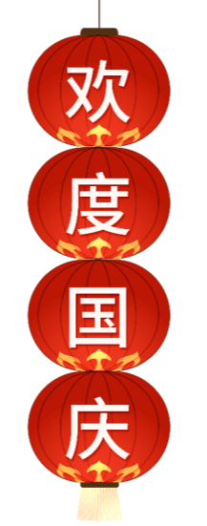
04
国庆节相关词句
National Day Related words and sentences
Motherland(祖国)
National Day国庆节
Happy National Day国庆快乐
Best wishes to my country.致以我的祖国美好的祝福。
| love my country deep.我深深地爱着我的祖国。
Strong and beautiful country like flowers.像鲜花-样美丽的祖国。
A tramendous dragon in east of Asia.东方升起的巨龙。

Slide 18
04
国庆节相关词句
National Day Related words and sentences
Yellow river, the Changjiang river, the great wall make a long territory.黄河，长江，长城铸就了伟大的江山。
Innovation , opening and development illumine the eye of the word. .改革，开放和发展点亮了世界的眼睛。

Slide 19
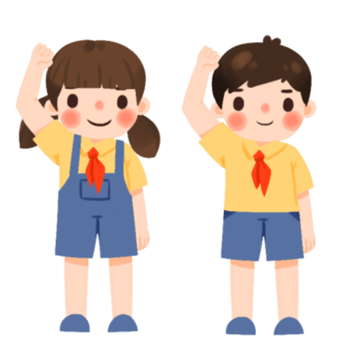
04
国庆节相关词句
National Day Related words and sentences
Sun of draw which is my contry .我的祖国是黎明的太阳。
My country Bassinet of east culture.祖国东方文明的摇篮。.
| love you my mom.我爱你,我的妈妈。
| am people's son , I love my country and people.我是人民的儿子，我深爱着我的祖国和人民.

Slide 20
National Day blessing
PART FIVE

Slide 21
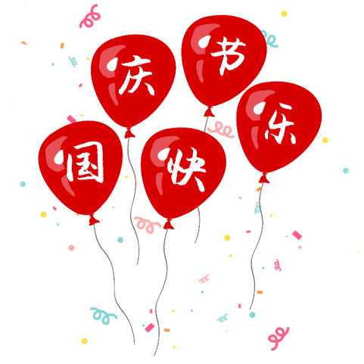
05
国庆节祝福语
National Day blessing
1、国庆节,祝你有美洋洋的心情， 尽享懒洋洋的时光。
National Day, | wish you a beautiful mood, enjoy lazy time.
2、国庆佳节就要到了,提前送上我的祝福，愿你幸福快乐。
National Day is coming. I wish you happiness ahead of time.
3、国庆国庆相亲相近，祖国腾~飞人民奋进!你奔小康我来鼓劲，为了明天我们前进!
The National Day is close, and the motherland is soaring. You kept me fairly well-off to tomorrow!
4、国庆到了，愿你开心无忧，幸福翱翔!
When the national day arrives, I wish you happiness and happiness.

Slide 22
05
国庆节祝福语
National Day blessing
5、国庆好运临，人间喜事连。真心祝你，幸福双双至，快乐到永远!国庆节快乐!
National Day is good luck. Sincerely wish you happiness and happiness forever! Happy National Day!
6、欢度国庆，举国同庆!这美好的日子，让我用最真挚的祝福陪你度过!国庆快乐!
Celebrate National Day and celebrate the whole nation! This beautiful day, let me use the most sincere blessing to accompany you! Happy National Day!

Slide 23
05
国庆节祝福语
National Day blessing
7、祖国繁荣享生活，阖家欢乐品幸福。祝朋友国庆快乐，幸福每天。
The motherland enjoys prosperity and happiness.
| wish my friends a happy National Day and a happy day.
8、祝你玩的开心，吃的放心，过的舒心，总之一切顺心!
| wish you a good time to enjoy your life.

Slide 24
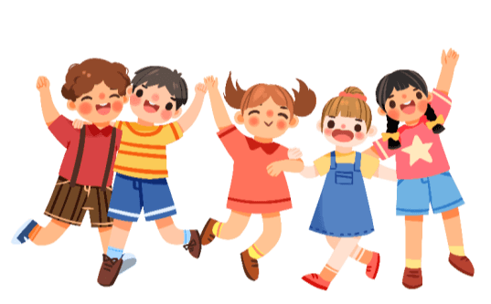
05
国庆节祝福语
National Day blessing
11、祝福伟大的祖国更加强盛，祝福祖国的人民天天向上。祝福你我口袋日见膨胀,祝福我们的爱人健康漂亮。
Bless the great motherland and become more prosperous. Bless the people of our motherland. Bless you, my pocket expands day by day, bless our lovers health and beauty
12、愿你喜事不断，向黄金周要一些财气， 愿你财富连连，国庆节快乐!
| wish you a lot of happiness. I wish you a lot of money in the golden week.

Slide 25
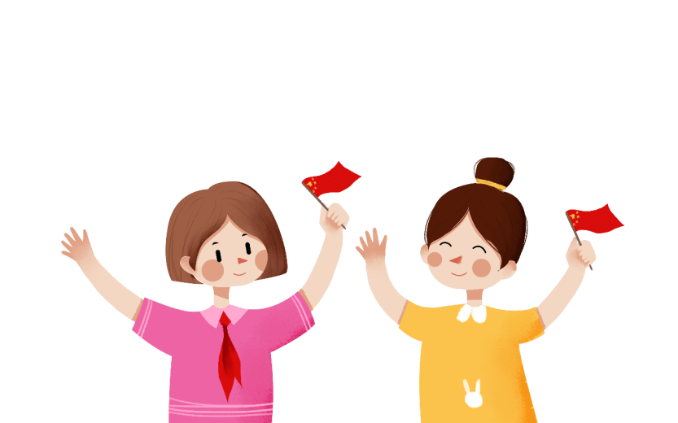
05
国庆节祝福语
National Day blessing
9、万紫千红迎国庆，片片红叶舞秋风。举国上下齐欢畅，家和国盛万事兴。
Red flowers and autumn wind. The whole nation is happy and prosperous.
10、岁月相伴，友情相守，人生四季与你携手。国庆节，祝你快乐到永久!
Time goes by, friends live together, and life goes hand in hand with you. Happy birthday to you on National Day!

Slide 26
National Day English Introduction
10月1日国庆节英文介绍

Slide 27
更多精品PPT资源尽在—优品PPT！
www.ypppt.com
PPT模板下载：www.ypppt.com/moban/ 节日PPT模板：www.ypppt.com/jieri/
PPT背景图片：www.ypppt.com/beijing/ PPT图表下载：www.ypppt.com/tubiao/
PPT素材下载： www.ypppt.com/sucai/ PPT教程下载：www.ypppt.com/jiaocheng/
字体下载：www.ypppt.com/ziti/ 绘本故事PPT：www.ypppt.com/gushi/
PPT课件：www.ypppt.com/kejian/
Notes:
模板来自于 优品PPT https://www.ypppt.com/

