Slide 1
新年快乐
Synergistically utilize technically sound portals with frictionless chainsSynergistically，Synergistically

Slide 2
01.
Synergistically utilize technically sound portals with frictionless chainsSynergistically
04.
Synergistically utilize technically sound portals with frictionless chainsSynergistically
02.
Synergistically utilize technically sound portals with frictionless chainsSynergistically
05.
Synergistically utilize technically sound portals with frictionless chainsSynergistically
03.
Synergistically utilize technically sound portals with frictionless chainsSynergistically
06.
Synergistically utilize technically sound portals with frictionless chainsSynergistically

Slide 3
壹
Synergistically utilize technically sound portals with frictionless chainsSynergistically，Synergistically

Slide 4
https://www.ypppt.com/
ypppt.COM
Synergistically utilize technically sound portals with, Synergistically, Synergistically utilize technically sound portals with, Synergistically
Synergistically utilize technically sound portals with, Synergistically, Synergistically utilize technically sound portals with, Synergistically
Synergistically utilize technically sound portals with, Synergistically, Synergistically utilize technically sound portals with, Synergistically

Slide 5
ypppt.COM
Synergistically utilize technically sound portals with, Synergistically
Synergistically utilize technically sound portals with, Synergistically
Synergistically utilize technically sound portals with, Synergistically
Synergistically utilize technically sound portals with, Synergistically
Synergistically utilize technically sound portals with, Synergistically
Synergistically utilize technically sound portals with, Synergistically

Slide 6
Synergistically utilize technically sound portals with, Synergistically utilize technically sound, Synergistically utilize technically sound portals with
ypppt.COM
Synergistically utilize technically sound portals with, Synergistically utilize technically sound, Synergistically utilize technically sound portals with
Synergistically utilize technically sound portals with, Synergistically utilize technically sound, Synergistically utilize technically sound portals with
ypppt.COM

Slide 7
贰
Synergistically utilize technically sound portals with frictionless chainsSynergistically，Synergistically

Slide 8
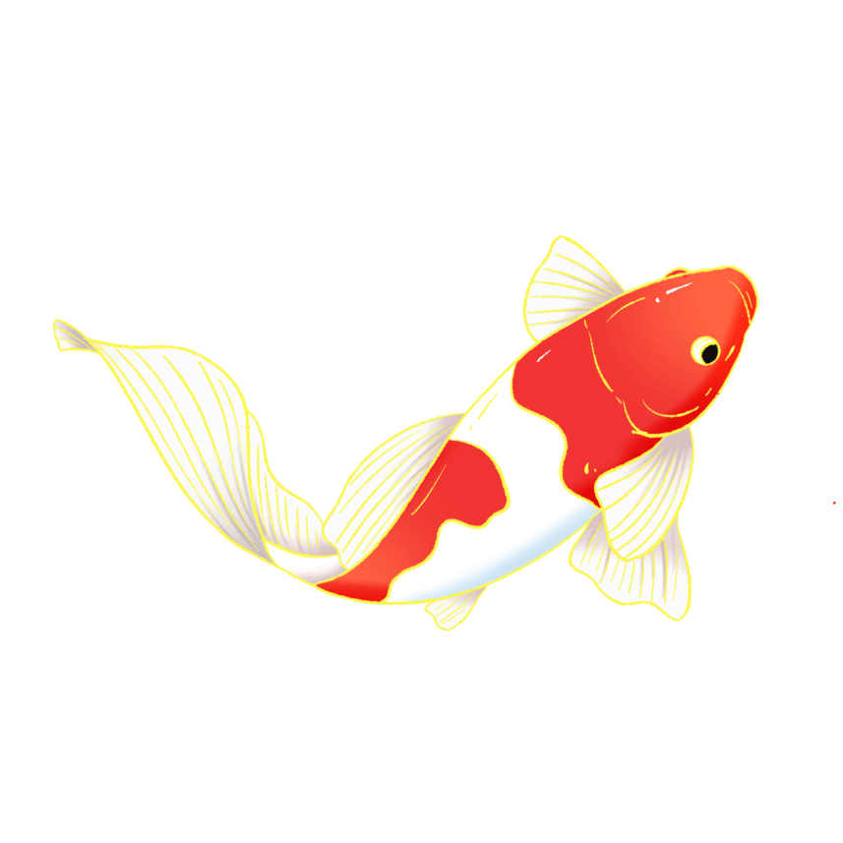
Synergistically utilize technically sound portals with, Synergistically utilize technically , Synergistically utilize technically sound portals with, Synergistically utilize technically sound, Synergistically
Synergistically utilize technically sound portals with, Synergistically utilize technically sound, Synergistically utilize technically sound portals with, Synergistically utilize technically sound portals with, Synergistically utilize technically sound, Synergistically

Slide 9
ypppt.COM
ypppt.COM
ypppt.COM
Synergistically utilize technically sound portals with, Synergistically utilize technically sound, Synergistically utilize technically sound portals with, Synergistically
Synergistically utilize technically sound portals with, Synergistically utilize technically sound, Synergistically utilize technically sound portals with, Synergistically
Synergistically utilize technically sound portals with, Synergistically utilize technically sound, Synergistically utilize technically sound portals with, Synergistically

Slide 10
Synergistically utilize technically sound portals with, Synergistically utilize technically sound, Synergistically utilize technically sound portals with, Synergistically
Synergistically utilize technically sound portals with, Synergistically utilize technically sound, Synergistically utilize technically sound portals with, Synergistically
Synergistically utilize technically sound portals with, Synergistically utilize technically sound, Synergistically utilize technically sound portals with, Synergistically

Slide 11
叁
Synergistically utilize technically sound portals with frictionless chainsSynergistically，Synergistically

Slide 12
01
Synergistically utilize technically sound portals with, Synergistically
02
Synergistically utilize technically sound portals with, Synergistically
03
Synergistically utilize technically sound portals with, Synergistically
04
Synergistically utilize technically sound portals with, Synergistically
05
Synergistically utilize technically sound portals with, Synergistically
06
Synergistically utilize technically sound portals with, Synergistically
Notes:
https://www.ypppt.com/

Slide 13
Synergistically utilize technically sound portals with, Synergistically, Synergistically utilize technically sound portals with,
Synergistically utilize technically sound portals with, Synergistically, Synergistically utilize technically sound portals with,
Synergistically utilize technically sound portals with, Synergistically, Synergistically utilize technically sound portals with,

Slide 14
1
Synergistically utilize technically sound portals with, Synergistically
4
Synergistically utilize technically sound portals with, Synergistically
New year
2
Synergistically utilize technically sound portals with, Synergistically
5
Synergistically utilize technically sound portals with, Synergistically
3
Synergistically utilize technically sound portals with, Synergistically
6
Synergistically utilize technically sound portals with, Synergistically

Slide 15
肆
Synergistically utilize technically sound portals with frictionless chainsSynergistically，Synergistically

Slide 16
45%
75%
20%
90%
65%
Synergistically utilize technically sound portals with, Synergistically utilize technically sound, Synergistically
Synergistically utilize technically sound portals with, Synergistically utilize technically sound, Synergistically
Synergistically utilize technically sound portals with, Synergistically utilize technically sound, Synergistically
Synergistically utilize technically sound portals with, Synergistically utilize technically sound, Synergistically
Synergistically utilize technically sound portals with, Synergistically utilize technically sound, Synergistically
节日PPT模板 http://www.ypppt.com/jieri/

Slide 17
Synergistically utilize technically sound portals with, Synergistically utilize technically sound, Synergistically utilize technically
Synergistically utilize technically sound portals with, Synergistically utilize technically sound, Synergistically utilize technically
Synergistically utilize technically sound portals with, Synergistically utilize technically sound, Synergistically utilize technically
Synergistically utilize technically sound portals with, Synergistically utilize technically sound, Synergistically utilize technically

Slide 18
Synergistically utilize technically sound portals with, Synergistically utilize technically sound,
Synergistically utilize technically sound portals with, Synergistically utilize technically sound,
Synergistically utilize technically sound portals with, Synergistically utilize technically sound,

Slide 19
伍
Synergistically utilize technically sound portals with frictionless chainsSynergistically，Synergistically

Slide 20
300,000
150,000
50,000
Synergistically utilize technically sound portals with, Synergistically utilize technically sound, Synergistically utilize technically，Synergistically utilize technically sound portals with, Synergistically utilize technically sound, Synergistically

Slide 21
50%
Synergistically utilize technically sound portals with, Synergistically utilize technically sound, Synergistically utilize technically
40%
Synergistically utilize technically sound portals with, Synergistically utilize technically sound, Synergistically utilize technically
10%
Synergistically utilize technically sound portals with, Synergistically utilize technically sound, Synergistically utilize technically

Slide 22
陆
Synergistically utilize technically sound portals with frictionless chainsSynergistically，Synergistically

Slide 23
ypppt.COM
Synergistically utilize technically sound portals with, Synergistically utilize technically sound, Synergistically utilize technically
ypppt.COM
Synergistically utilize technically sound portals with, Synergistically utilize technically sound, Synergistically utilize technically
ypppt.COM
Synergistically utilize technically sound portals with, Synergistically utilize technically sound, Synergistically utilize technically

Slide 24
Synergistically utilize technically sound portals with, Synergistically
Synergistically utilize technically sound portals with, Synergistically
Synergistically utilize technically sound portals with, Synergistically
Synergistically utilize technically sound portals with, Synergistically

Slide 25
祝大家
新年快乐
Synergistically utilize technically sound portals with frictionless chainsSynergistically，Synergistically，Synergistically utilize technically sound portals with frictionless chainsSynergistically

Slide 26
更多精品PPT资源尽在—优品PPT！
www.ypppt.com
PPT模板下载：www.ypppt.com/moban/ 节日PPT模板：www.ypppt.com/jieri/
PPT背景图片：www.ypppt.com/beijing/ PPT图表下载：www.ypppt.com/tubiao/
PPT素材下载： www.ypppt.com/sucai/ PPT教程下载：www.ypppt.com/jiaocheng/
字体下载：www.ypppt.com/ziti/ 绘本故事PPT：www.ypppt.com/gushi/
PPT课件：www.ypppt.com/kejian/
Notes:
模板来自于 优品PPT https://www.ypppt.com/

