Slide 1
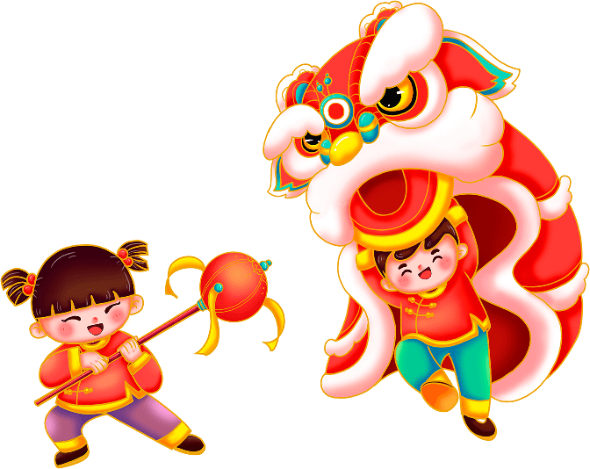
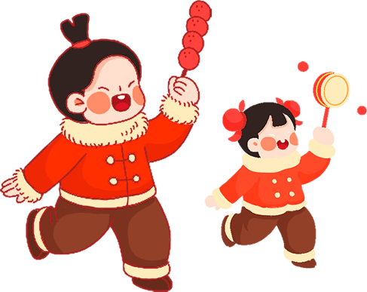
春 节 英 文 介 绍

Slide 2
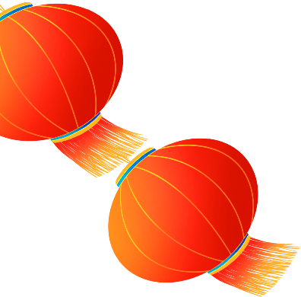
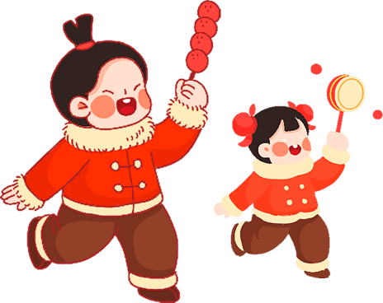
https://www.ypppt.com/
It falls on the first day of the first Chinese lunar month and the celebration last from the 23rd of the 12th lunar month up to the 15th of the first lunar month next year.

Slide 3
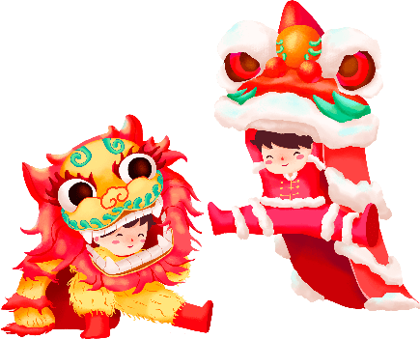
目录/contents
1
The legend of nian
4
Festival activites
2
Customs of the Spring Festival
5
Chinese zodiac
3
Traditional food

Slide 4
The legend of “nian”

Slide 5
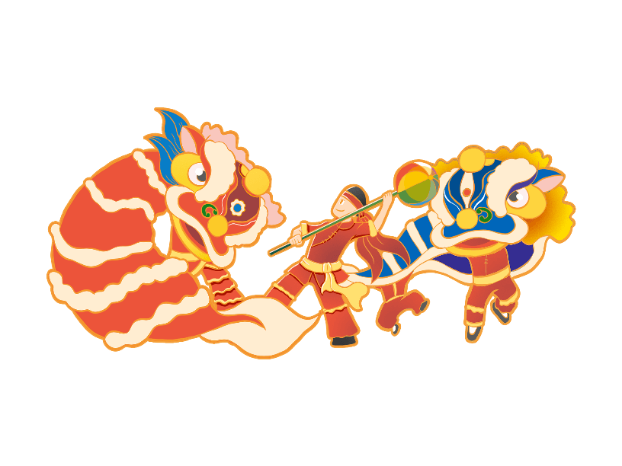
The legend of nian
According to legend, there was a man-eating wild monster "Nian" with an extremely large mouth, capable of swallowing several people in a single bite.
This beast appeared in a country village, towards the end of winter when there was nothing to eat it would visit the villages and attack and eat whatever it could. The villagers would live in terror over the winter.

Slide 6
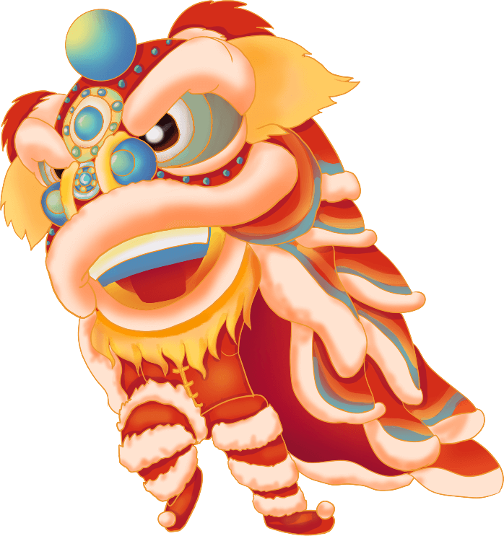
The legend of nian
One day, a wise old man passed through the village and told an old woman, "I will teach you how to scare Nian away!"
One day, a wise old man passed through the village and told an old woman, "I will teach you how to scare Nian away!"

Slide 7
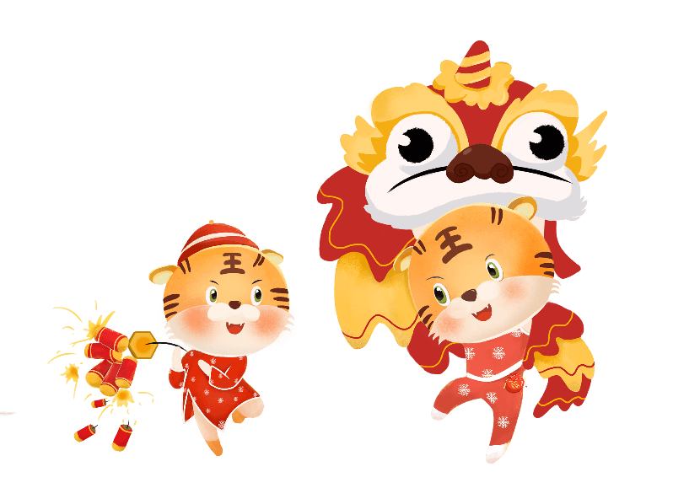
The legend of nian
That evening when Nian arrived at the village, he saw that all the houses were dark except the house in which an old woman lived. Nian approached the house, licking his lips in anticipation.
Suddenly, the deafening noise of firecrackers sounded endlessly.

Slide 8
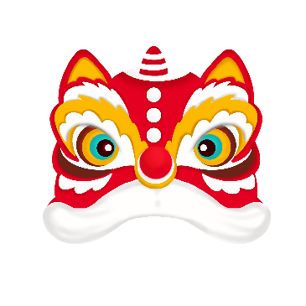
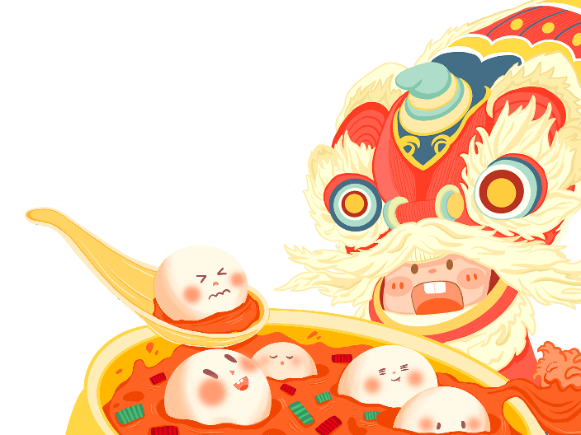
The legend of nian
The monster was startled and jumped. Suddenly he realized that the house was covered in red paper. This scared him even more and it ran off into the mountains. When the villagers returned they saw that the old woman was unharmed!

Slide 9
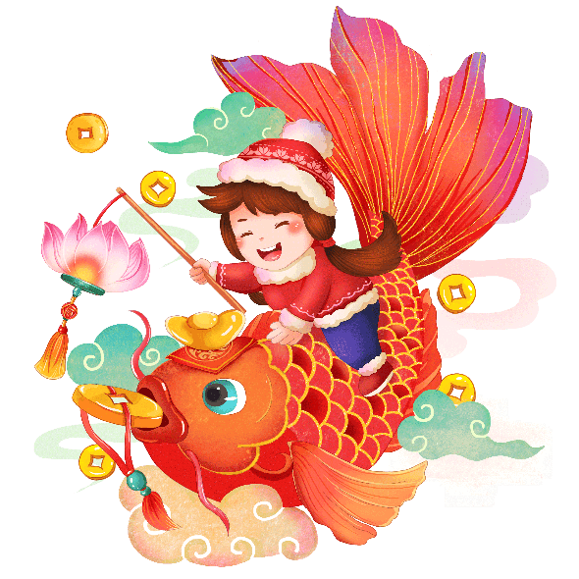
The legend of nian
People later learned that "nian" was afraid of loud noises and the color red.
The villagers came together and agreed that when it was time for Nian's annual visit towards the end of winter they would start a fire in front of every door and not go to sleep but rather make noise.
节日PPT模板 http://www.ypppt.com/jieri/

Slide 10
Customs of the Spring Festival

Slide 11
Customs of the Spring Festival
Sweeping the dust
Pasting “up-sided Fu”
New year’s visit
Pasting Spring Couplets
Set off fireworks
Gift money

Slide 12
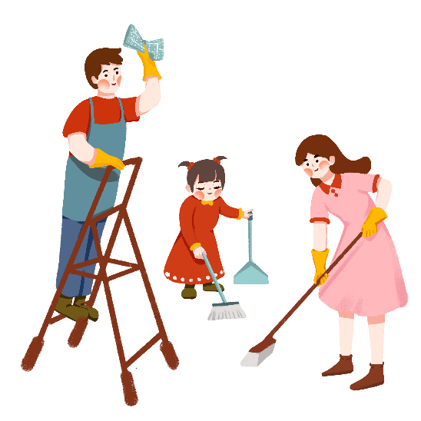
Customs of the Spring Festival
Sweeping the dust
“dust”in Chinese means old and past. This custom shows a good wish of putting away old things to welcome a new life.

Slide 13
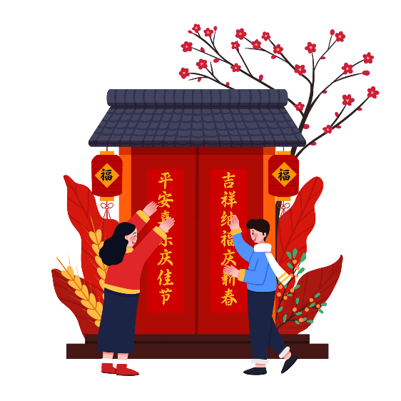
Customs of the Spring Festival
Pasting Spring Couplets
On the eve of the Spring Festival, every household will paste on doors a spring couplets written on red paper to give a happy and prosperous atmosphere of the Festival.

Slide 14
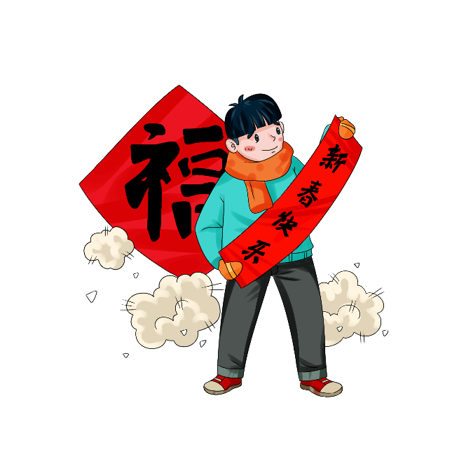
Customs of the Spring Festival
Pasting “up-sided Fu
“Fu”shows people’s yearning toward a good life.Some people even invert the Character”fu”to signify that blessing has arrived because “inverted”is a homonym for “arrive”in Chinese.

Slide 15
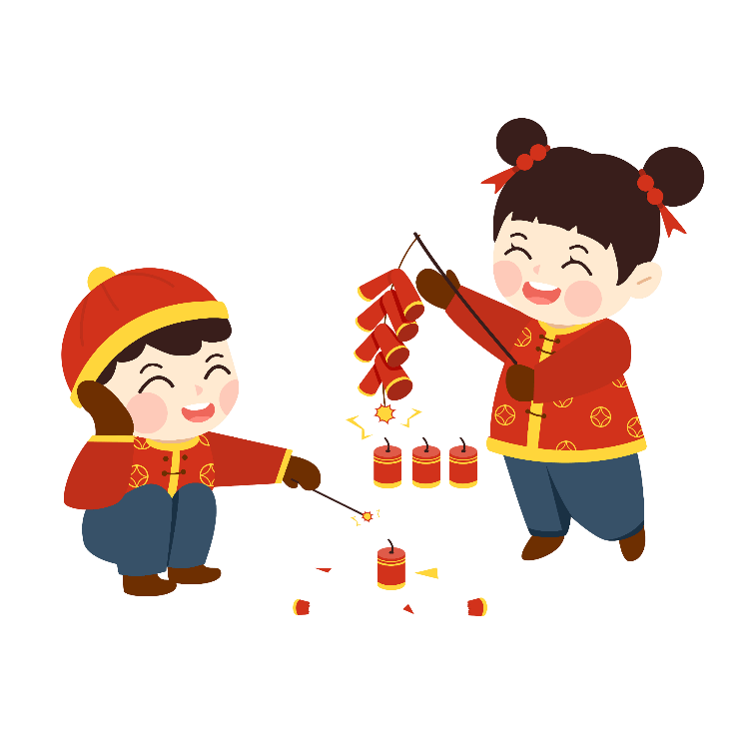
Customs of the Spring Festival
Set off fireworks
The first thing every Chinese household does is to set off fireworks and firecrackeras
Notes:
https://www.ypppt.com/

Slide 16
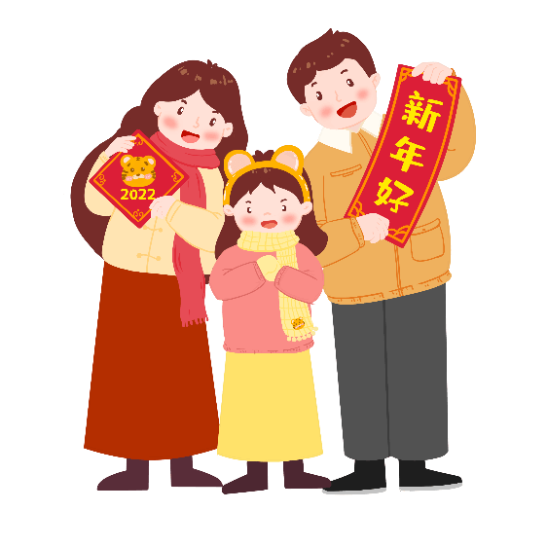
Customs of the Spring Festival
New year’s visit
On the first day of the Chinese lunar year, everybody puts on their best clothes and pay ceremonial calls on their relatives and friends, wishing them all the luck in the coming year.

Slide 17
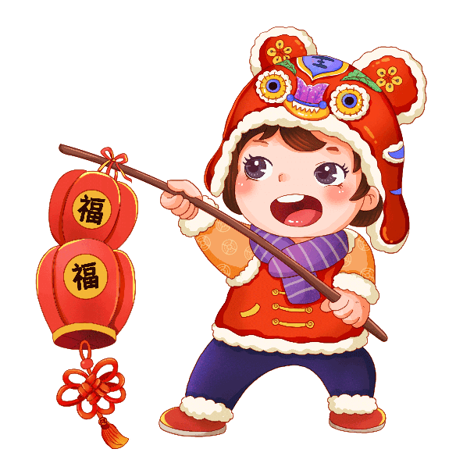
Customs of the Spring Festival
Traditional Festival Greetings
恭喜发财 Wish You Prosperity
步步高升 Promoting to a high position
吉祥如意 Everything goes well
岁岁平安 Peace all year round

Slide 18
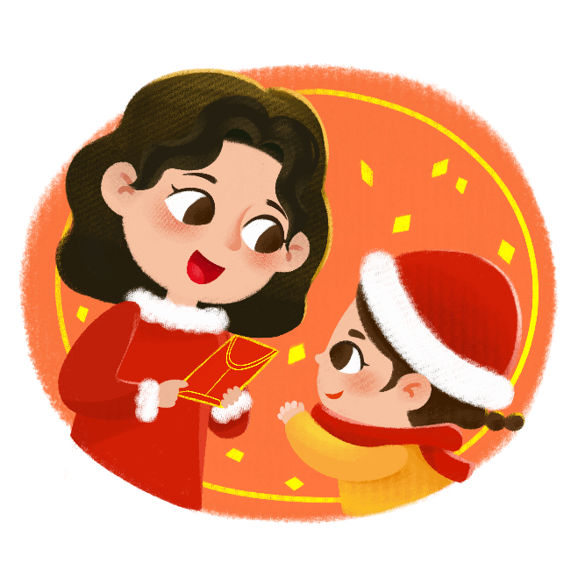
Customs of the Spring Festival
Gift money
Juniors will greet seniors, wishing them health and longevity, while seniors will give juniors some gift money as wish for their safety in the coming year.

Slide 19
Traditional food

Slide 20
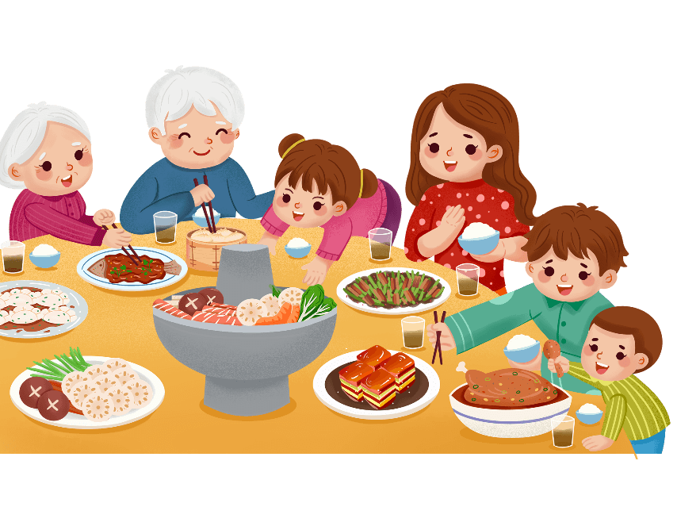
Traditional food
The dinner on new year’s eve
Dumpling and fish are must during the Family Reunion Dinner on New Year's Eve. Some people will put a coin inside one dumpling. The people who
eat this dumpling will be to thought be a lucky guy.
The fish could not be eaten out because the fish
means extra things by partial tone. And it
represents the wish for a prosperous year with
abundant and even extra wealth and luck.

Slide 21
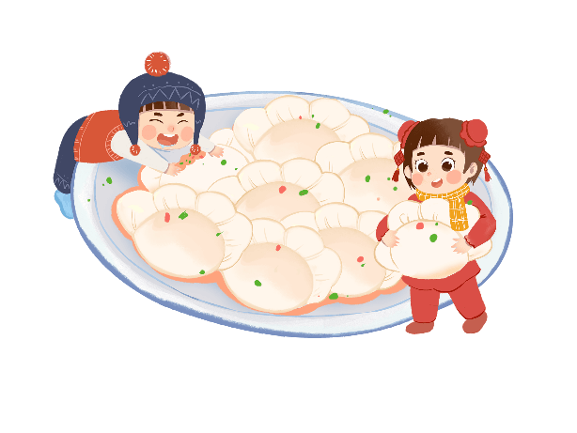
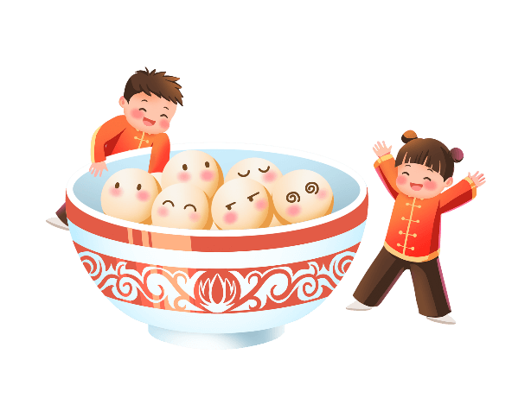
Traditional food
Traditional food
饺子
Dumplings
汤圆
Sweet soup balls

Slide 22
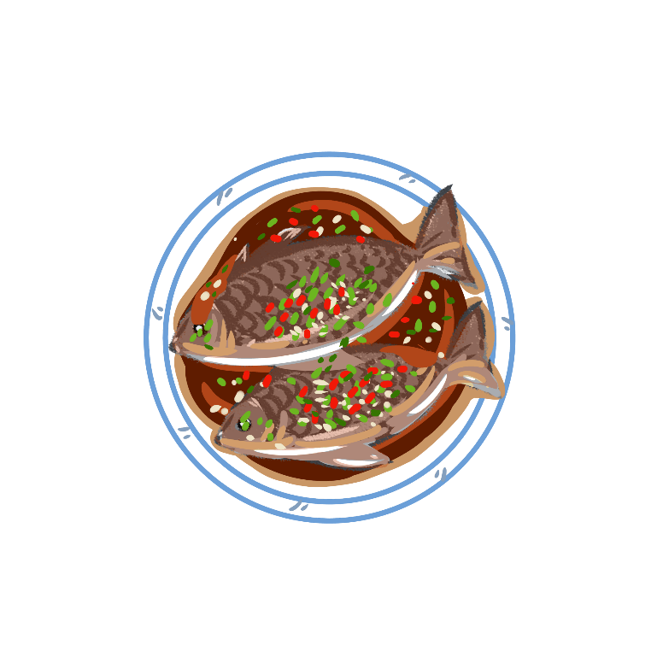
Traditional food
Traditional food
鱼
fish

Slide 23
Festival activites

Slide 24
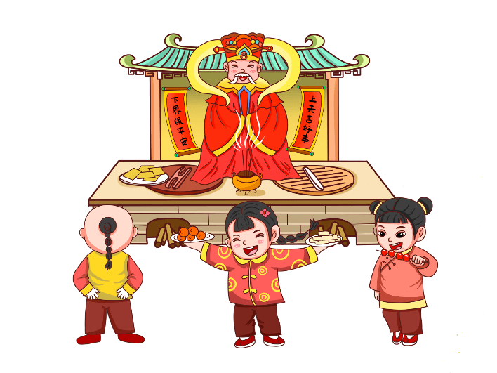
Festival activites
Welcome the gods
People began their day by offerin prayers and welcome the gods of heaven and earth. Most of the people stay away from meat to ensure healthy living

Slide 25
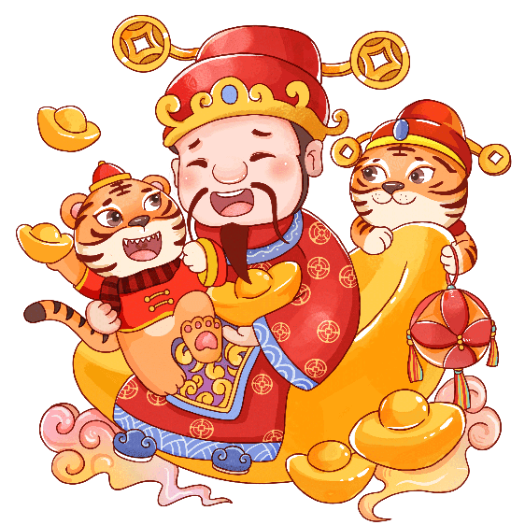
Festival activites
Worship the god of wealth
According to the traditions, nobodyvisits friends and relatives houses as it would bring bad omen.They stay back home to worship the god of wealth.The day is called Po Woo.

Slide 26
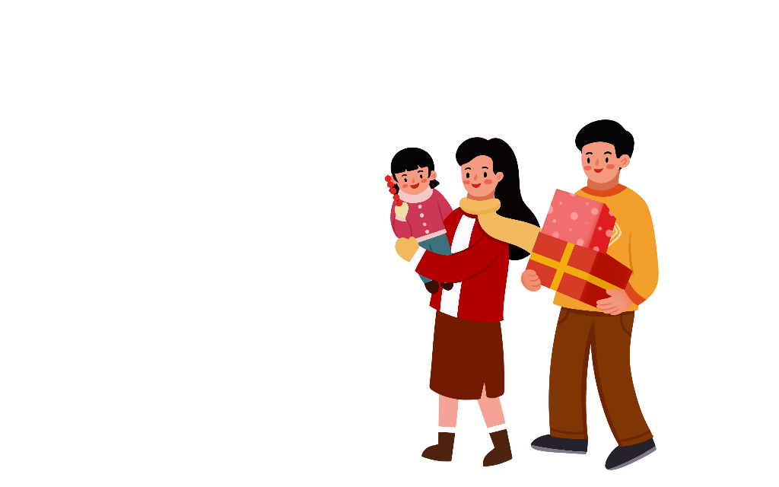
Festival activites
Temple Fair
Temple fair,usually held outside temples, is a kind of folk customs in China. It is one of the most important activites, in which there are such performances as acrobatics and Wushu, numerous kinds of local snacks and many kind of things for everyday life.

Slide 27
Chinese zodiac

Slide 28
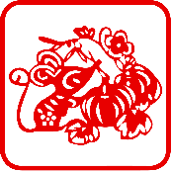
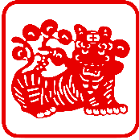
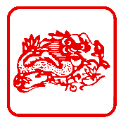
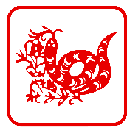
Chinese zodiac
十
SHI
二
ER
生
SHENG
肖
XIAO
子（zǐ）鼠
丑 (chǒu )牛
寅 (yín ) 虎
卯 (mǎo ) 兔
辰 (chén )龙
巳 (si) 蛇
午 (wǔ ) 马
未(wèi )羊
申(shēn ) 猴
酉(yǒu )鸡
戌 (xū ) 狗
亥 (hài ) 猪

Slide 29
春 节 英 文 介 绍

Slide 30
更多精品PPT资源尽在—优品PPT！
www.ypppt.com
PPT模板下载：www.ypppt.com/moban/ 节日PPT模板：www.ypppt.com/jieri/
PPT背景图片：www.ypppt.com/beijing/ PPT图表下载：www.ypppt.com/tubiao/
PPT素材下载： www.ypppt.com/sucai/ PPT教程下载：www.ypppt.com/jiaocheng/
字体下载：www.ypppt.com/ziti/ 绘本故事PPT：www.ypppt.com/gushi/
PPT课件：www.ypppt.com/kejian/
Notes:
模板来自于 优品PPT https://www.ypppt.com/

