Slide 1
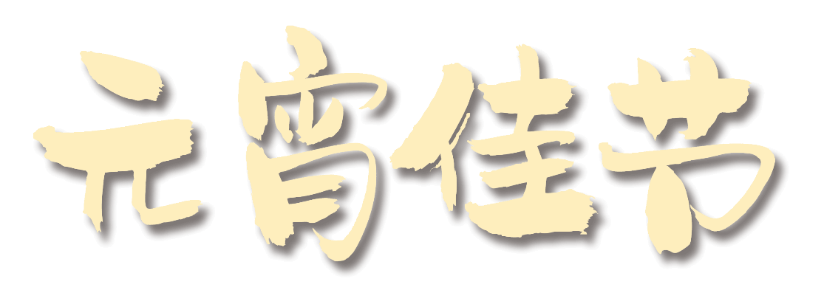
欢●天●喜●地●闹●元●宵
The formation of the Lantern Festival has a long process, which is rooted in the ancient custom of turning on lights and praying. According to general information and folklore, the fifteenth day of the first month has been paid attention to in the Western Han Dynasty, but the Lantern Festival on the fifteenth day of the first month was really regarded as a national folk festival after the Han and Wei dynasties. The rise of the custom of lighting lanterns on the 15th day of the first month is also related to the eastward spread of Buddhism. Buddhism flourished in the Tang Dynasty. Officials and people generally "light lanterns for Buddha" on the 15th day of the first month, and Buddhist lights spread all over the people. Since the Tang Dynasty, openin

Slide 2
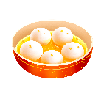
https://www.ypppt.com/
目 录
元宵灯谜猜猜猜
DIY花灯同祈愿
搓元宵品团圆

Slide 3
第一部分
元宵灯谜猜猜猜
The formation of the Lantern Festival has a long process, which is rooted in the ancient custom of turning on lights and praying. According to general information and folklore, the fifteenth day of the first month has been paid attention to in the Western Han Dynasty, but the Lantern Festival on the fifteenth day of the first month was really regarded as a national folk festival after the Han and Wei dynasties. The rise of the custom of lighting lanterns on the 15th day of the first month is also related to the eastward spread of Buddhism. Buddhism flourished in the Tang Dynasty. Officials and people generally "light lanterns for Buddha" on the 15th day of the first month, and Buddhist lights spread all over the people. Since the Tang Dynasty, openin

Slide 4
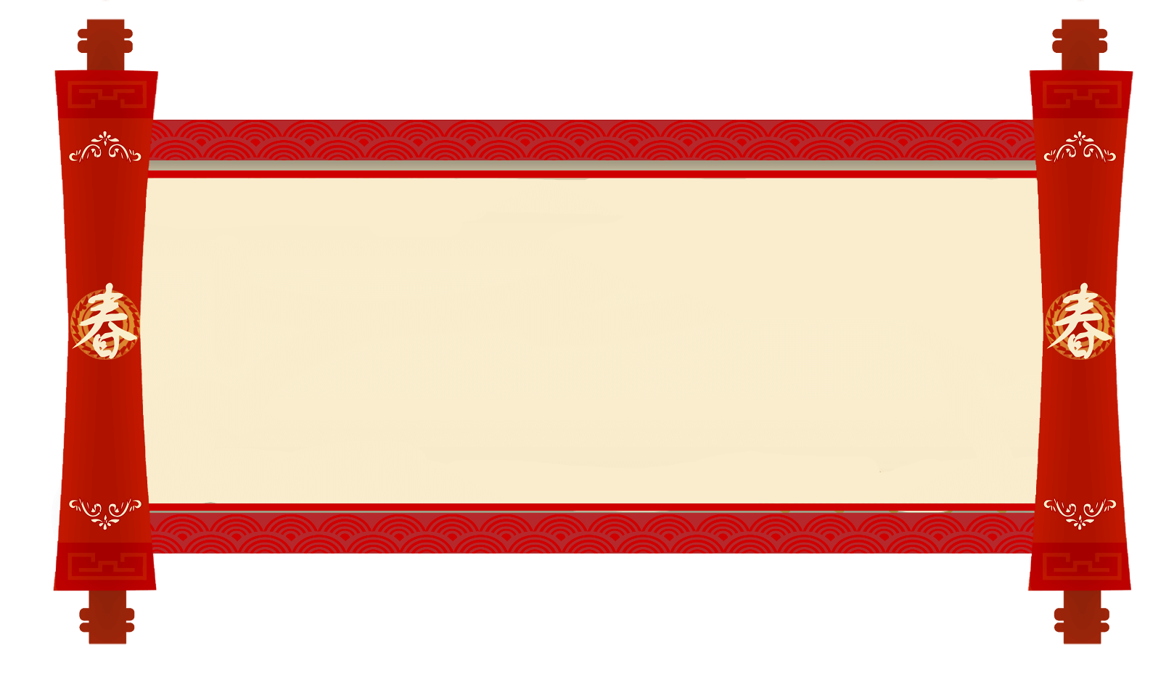
谜 面
中间火山，四边大海。
海里宝贝多，快快捞上来。
（打一餐饮类型）
谜底：火锅

Slide 5
谜 面
太阳西边下，月亮东边挂。
（打一汉字）
谜底：明

Slide 6
谜 面
红娘子，上高楼。
心里疼，眼泪流。
（打一日常用品）
谜底：蜡烛

Slide 7
谜 面
前面来只船，舵手在上边。
来时下小雨，走后路已干。
（打一日常物品）
谜底：熨斗

Slide 8
谜 面
有吃有穿生活好
（打一字）
谜底：裕

Slide 9
谜 面
生在山崖，落在人家。
凉水浇背，千刀万剐。
（打一日常用品）
谜底：磨刀石

Slide 10
谜 面
开门日正中
（打一字）
谜底：简
节日PPT模板 http://www.ypppt.com/jieri/

Slide 11
谜 面
身自端方，体自坚硬。
虽不能言，有言必应。
（打一物品）
谜底：砚台

Slide 12
谜 面
一口吃掉牛尾巴
（打一字）
谜底：告
Notes:
https://www.ypppt.com/

Slide 13
谜 面
牛郎放牧
（打一花卉）
谜底：牵牛花

Slide 14
谜 面
千里走单骑
（猜一字）
谜底：奇

Slide 15
谜 面
千里一线穿
（猜一字）
谜底：重

Slide 16
第二部分
DIY花灯同祈愿
The formation of the Lantern Festival has a long process, which is rooted in the ancient custom of turning on lights and praying. According to general information and folklore, the fifteenth day of the first month has been paid attention to in the Western Han Dynasty, but the Lantern Festival on the fifteenth day of the first month was really regarded as a national folk festival after the Han and Wei dynasties. The rise of the custom of lighting lanterns on the 15th day of the first month is also related to the eastward spread of Buddhism. Buddhism flourished in the Tang Dynasty. Officials and people generally "light lanterns for Buddha" on the 15th day of the first month, and Buddhist lights spread all over the people. Since the Tang Dynasty, openin

Slide 17
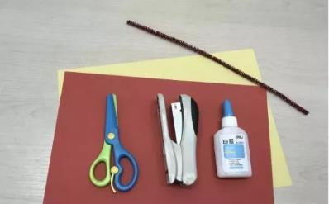
手作花灯、祈愿新年
准备材料：
红色、黄色画纸各1张，安全剪刀1把，订书机1个，白乳胶或胶棒、红色毛根各1个。

Slide 18
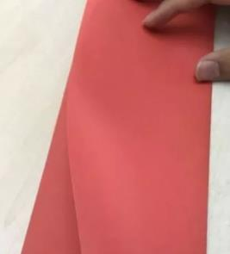
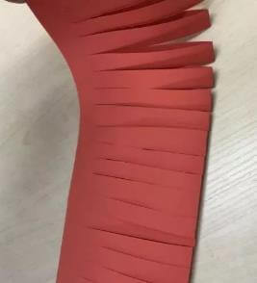
手作花灯、祈愿新年
制作方法：
1.将红纸横向对折，用安全剪刀由折叠处等距离裁剪红纸。

Slide 19
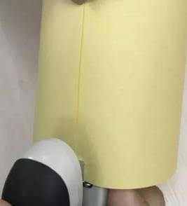
手作花灯、祈愿新年
制作方法：
2.将黄色画纸横向折一小部分后撕去，剩下的画纸沿长边卷起，用订书机固定开口处。

Slide 20
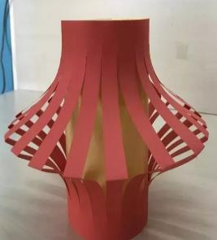
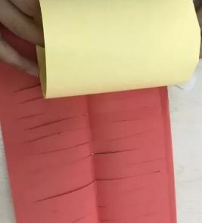
手作花灯、祈愿新年
制作方法：
3.将剪裁好的红色画纸两长边涂上白乳胶，按下图所示围着黄色直筒卷起来。

Slide 21
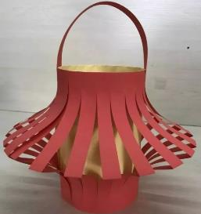
手作花灯、祈愿新年
制作方法：
4.粘贴细长红纸条做灯笼提手，彩纸灯笼制作完成。

Slide 22
第三部分
搓元宵品团圆
The formation of the Lantern Festival has a long process, which is rooted in the ancient custom of turning on lights and praying. According to general information and folklore, the fifteenth day of the first month has been paid attention to in the Western Han Dynasty, but the Lantern Festival on the fifteenth day of the first month was really regarded as a national folk festival after the Han and Wei dynasties. The rise of the custom of lighting lanterns on the 15th day of the first month is also related to the eastward spread of Buddhism. Buddhism flourished in the Tang Dynasty. Officials and people generally "light lanterns for Buddha" on the 15th day of the first month, and Buddhist lights spread all over the people. Since the Tang Dynasty, openin

Slide 23
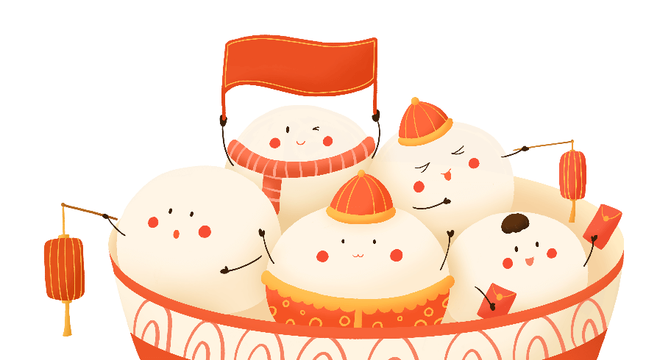
搓元宵品团圆
“包”汤圆“滚”元宵
和和美美共团圆

Slide 24
祝福大家元宵节快乐！
The formation of the Lantern Festival has a long process, which is rooted in the ancient custom of turning on lights and praying. According to general information and folklore, the fifteenth day of the first month has been paid attention to in the Western Han Dynasty, but the Lantern Festival on the fifteenth day of the first month was really regarded as a national folk festival after the Han and Wei dynasties. The rise of the custom of lighting lanterns on the 15th day of the first month is also related to the eastward spread of Buddhism. Buddhism flourished in the Tang Dynasty. Officials and people generally "light lanterns for Buddha" on the 15th day of the first month, and Buddhist lights spread all over the people. Since the Tang Dynasty, openin

Slide 25
更多精品PPT资源尽在—优品PPT！
www.ypppt.com
PPT模板下载：www.ypppt.com/moban/ 节日PPT模板：www.ypppt.com/jieri/
PPT背景图片：www.ypppt.com/beijing/ PPT图表下载：www.ypppt.com/tubiao/
PPT素材下载： www.ypppt.com/sucai/ PPT教程下载：www.ypppt.com/jiaocheng/
字体下载：www.ypppt.com/ziti/ 绘本故事PPT：www.ypppt.com/gushi/
PPT课件：www.ypppt.com/kejian/
Notes:
模板来自于 优品PPT https://www.ypppt.com/

